Slide 1

Setting up SSL on Apache2

Slide 2
Symmetrical and Asymmetrical Encryption
Symmetrical Encryption Involves a single Key
Messages are both Encrypted and Decrypted using that single key
Fairly swift process that is not overly complex.
Asymmetrical Encryption involves the use of Public/Private Key set
Message encrypted using a public key can only be decrypted using the private key and vice-versa
This is actually a complex process that is much slower than working with Symmetrical keys
With regards to Web Based traffic that might contain sensitive information
Symmetrical is better but how do we distribute the keys to everyone in a timely fashion
Today we will be talking about setting up SSL (Secure Socket Layer) Communication between a Client and a host and showing how we can get to the point of working with symmetrical keys.
Note: We are actually setting up TLS (Transport Layer Security) which is the new name for what used to be SSL.

Slide 3

Man-in-the-Middle Attack (Exchange of Keys)
One of the problems when setting up an exchange of public/private keys between two individuals to do encrypted communication is the Man-in-the-middle attack.
Consider Bob and Alice wish to talk to each other by exchanging information on their public and private keys
Problem is how does Bob Send his private key to Alice without it being read by someone else (Peter is the bad Actor here)

Slide 4
MITM Attack
Bob
Peter
Alice
Bobs Public Key
Peters’ public key
Alice’ public key
Peters’ public key
Account Number 12345 (encypted)
Account number 78651 (encypted)
Transfer to account 78651
(encypted)

Slide 5
The Role of the Certificate Authority
The certificate authority is a recognized company that ensures “You are who you say you are.”
Depending upon the level of security required – these companies will issue Certificates to clients that are uniquely signed with the private key of the CA.
Process
Company asks for a SSL Certificate
Provide necessary information and proof of who they are.
You will also need to provide a public key that can be used to encrypt information sent to your site
This information will be encoded (using the CA Private Key) and singed (once again using the CA Private key
Standard web browsers come with a list of Trusted CA’s and their associated public keys
The public keys can be used to decrypt any messages (certificates) that are encrypted using the Private CA key
https://letsencrypt.org is a FREE certificate authority.

Slide 6
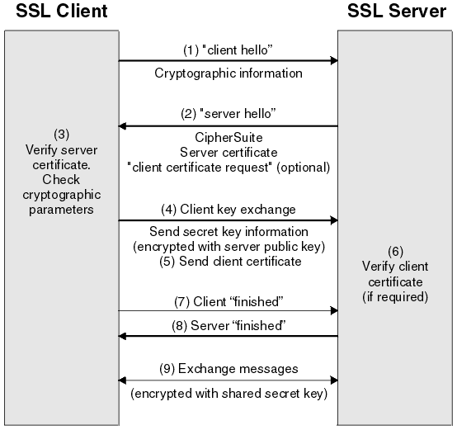
SSL Handshake
The SSL handshake happens after the TCP handshake.

Slide 7
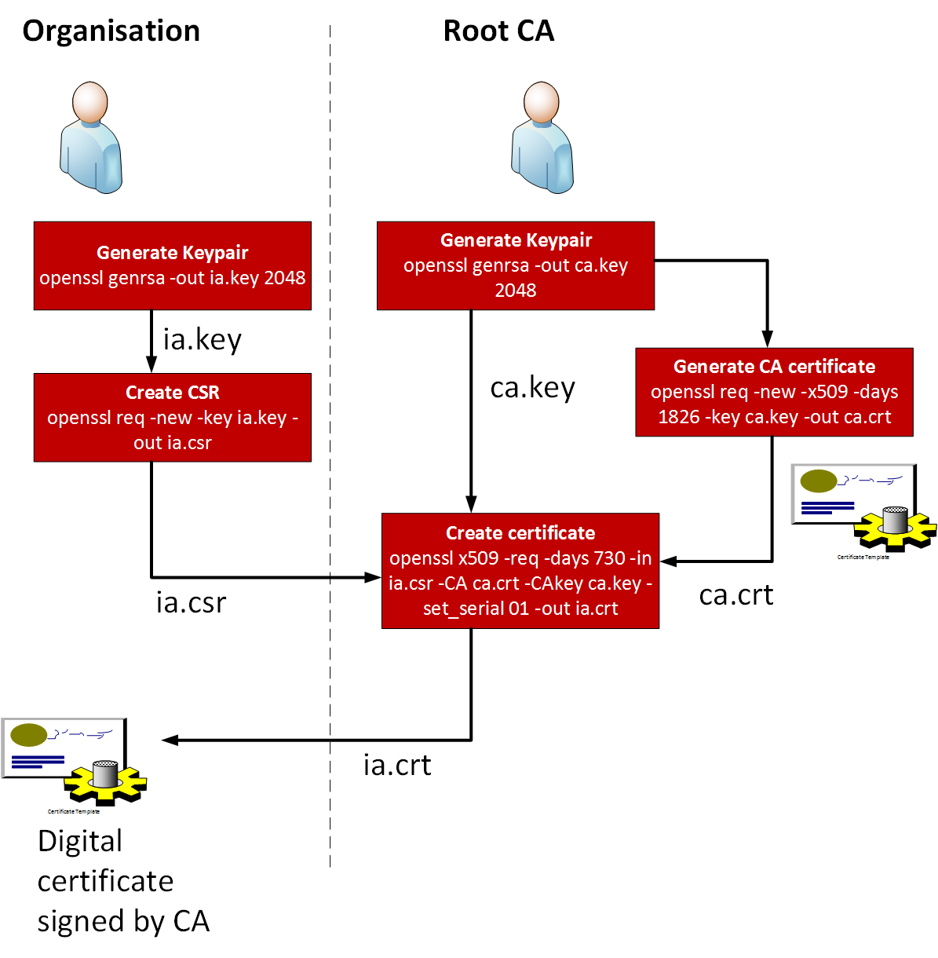
Certificate Request

Slide 8
Today’s exercise:
We are going to generate a Self-Signed Certificate for the AvengersHQ website.
Self-signed certificates are not signed by a Certificate Authority and as such, do not provide security against MITM attacks.
This would be appropriate to use for testing.
Free certificates (letsencrypt.org) have made Self-Signed certificates less common.

Slide 9
Step 1: Install Apache module mod_ssl
Run the following three commands:
sudo a2enmod ssl
sudo apache2ctl configtest
sudo systemctl restart apache2
After this, Apache is now ready to use encryption!

Slide 10
Step 2: Generate a Self-Signed SSL Certificate
SSL certificates store basic information about your site.
The certificate comes with a key file that allows the server to securely handle encrypted data.
To generate the SSL certificate for our AvengersHQ website we use the openssl command:
sudo openssl req -x509 -nodes -days 365 -newkey rsa:2048 -keyout /etc/ssl/private/avengershq.key -out /etc/ssl/certs/avengershq.crt
req - Specifies the server signing request uses the x509 protocol
-x509 - Certificate Data Management
-nodes - Skip the option to start apache2 with a pass phrase
-days 365 - Number of days certification is to be valid for (365)
-newkey rsa:2048 - generate a new key and certificate at the same time
-keyout - where to place the private key file
-out - where to place the certificate we are creating

Slide 11
Step 2: Edit the site .conf file to enable SSL
Edite the AvengersHQ configuration file:
Make a backup of this file: cp avengershq.conf{,.bak}
vi /etc/apache2/sites-available/avengershq.conf
In the first line change the port number from 80 to 443
Add the following three lines to the file after the CustomLog
SSLEngine on
SSLCertificateFile /etc/ssl/certs/avengershq.crt
SSLCertificateKeyFile /etc/ssl/private/avengershq.key
Note: SSLEngine, SSLCertificateFile, SSLCertificateKeyFile are new directives that we need to use to enable SSL and https

Slide 12
Step 3: Testing on the browser
Now, when we browse to https://www.avengershq.com Firefox will give us a big warning stating that the server we are trying to reach has signed it’s own certificate
This is a big no-no for Production systems, but ok for us to test locally.

Slide 13
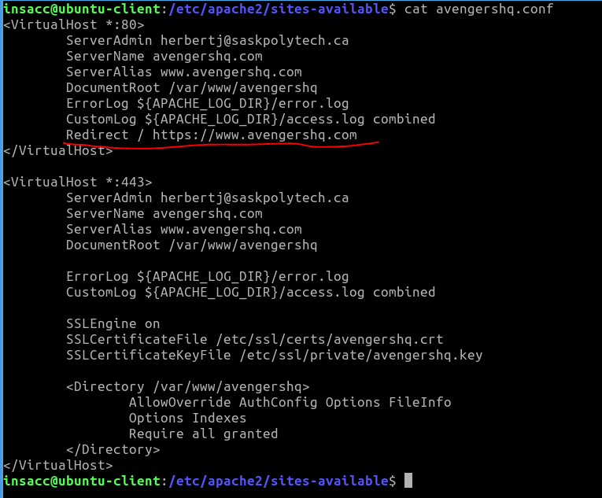
Step 4: Redirect from http to https
We can automatically redirect traffic coming over HTTP to HTTPS using a single directive within our avengershq.conf.
Don’t forget to configtest and reload!
After making these changes browsing to http://www.avengershq.com should redirect us automatically to https://www.avengershq.com

